Slide 1
Artificial Neural Networks (ANN)
Dr. Md. Golam Rabiul Alam
Associate Professor, CSE, BRACU

Slide 2
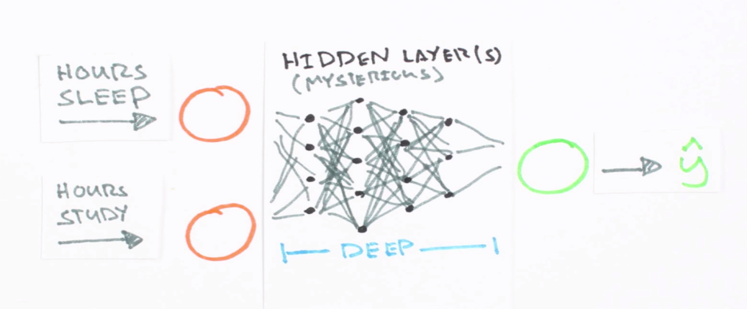
Neural Network
Artificial neural networks are statistical learning models, inspired by biological neural networks (central nervous systems, such as the brain), that are used in machine learning.

Slide 3
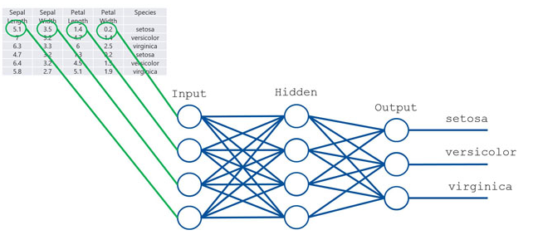
Neural Network

Slide 4
Training in Neural Networks
Forward Propagation
Backward Propagation

Slide 5
Forward Propagation

Slide 6

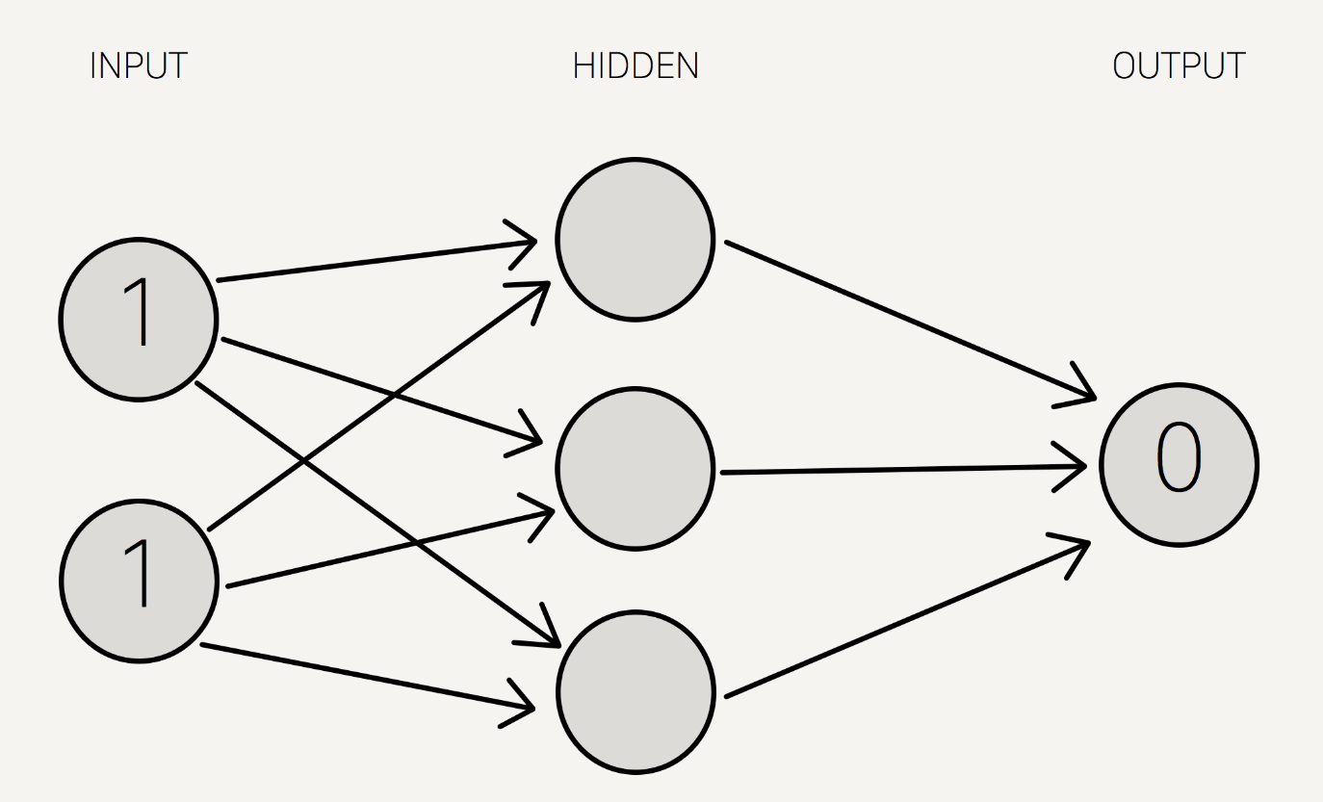
Example
w1
h1
w7
w2
w3
h2
w4
w8
w5
h3
w9
w6
h1=x1*w1+x2*w4
h2=x1*w2+x2*w5
h3=x1*w3+x2*w6
sum =s(h1)*w7+s(h2)*w8+s(h3)*w9
calculated = s(sum)

Slide 7
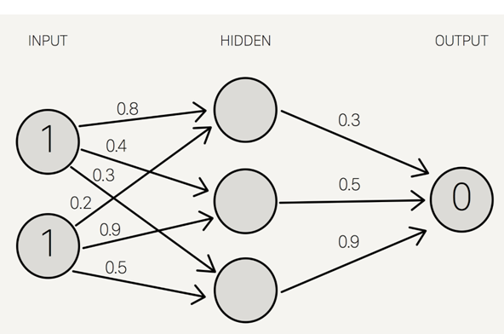
Example

Slide 8
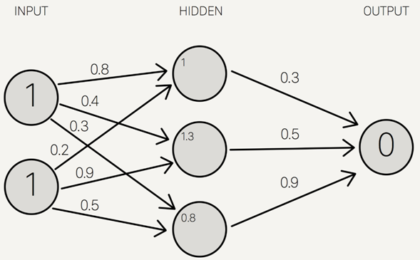
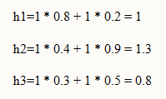
Example
h1=x1*w1+x2*w4
h2=x1*w2+x2*w5
h3=x1*w3+x2*w6
S(1.0) = 0.73105857863
S(1.3) = 0.78583498304
S(0.8) = 0.68997448112

Slide 9
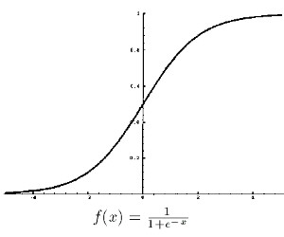
Apply activation function

Slide 10
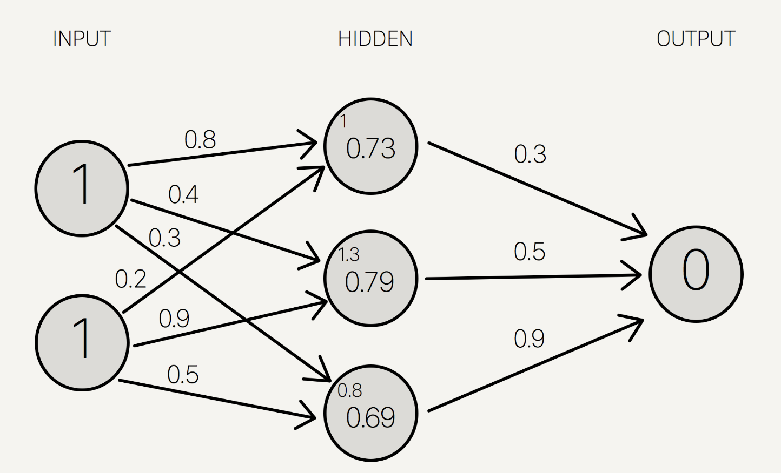
Example
h1=x1*w1+x2*w4
h2=x1*w2+x2*w5
h3=x1*w3+x2*w6
S(1.0) = 0.73105857863
S(1.3) = 0.78583498304
S(0.8) = 0.68997448112

Slide 11
Example
h1=x1*w1+x2*w4
h2=x1*w2+x2*w5
h3=x1*w3+x2*w6
S(1.0) = 0.73105857863
S(1.3) = 0.78583498304
S(0.8) = 0.68997448112
sum =s(h1)*w7+s(h2)*w8+s(h3)*w9
calculated = s(sum)
sum =0.73 * 0.3 + 0.79 * 0.5 + 0.69 * 0.9 = 1.235
calculated =S(1.235) = 0.7746924929149283

Slide 12
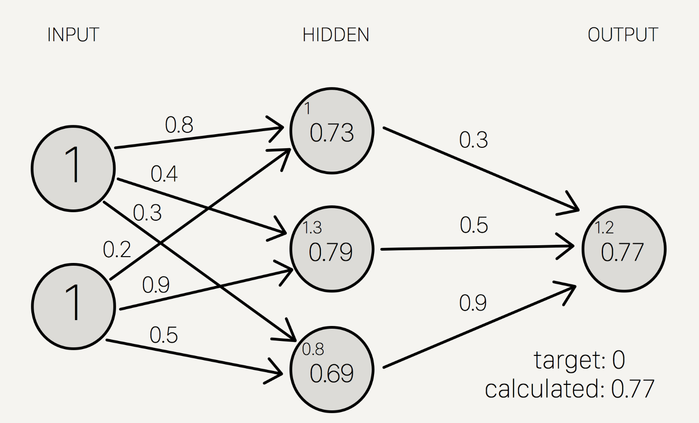
Example
h1=x1*w1+x2*w4
h2=x1*w2+x2*w5
h3=x1*w3+x2*w6
S(1.0) = 0.73105857863
S(1.3) = 0.78583498304
S(0.8) = 0.68997448112
sum =s(h1)*w7+s(h2)*w8+s(h3)*w9
calculated = s(sum)
sum =0.73 * 0.3 + 0.79 * 0.5 + 0.69 * 0.9 = 1.235
calculated=S(1.235) = 0.7746924929149283

Slide 13
Backward Propagation

Slide 14

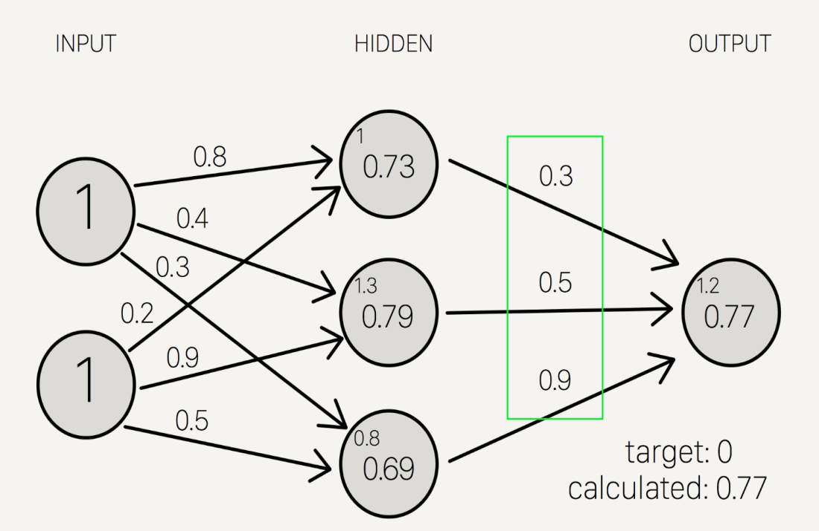
Example
Target = 0
Calculated = 0.77
Target - calculated = -0.77

Slide 15
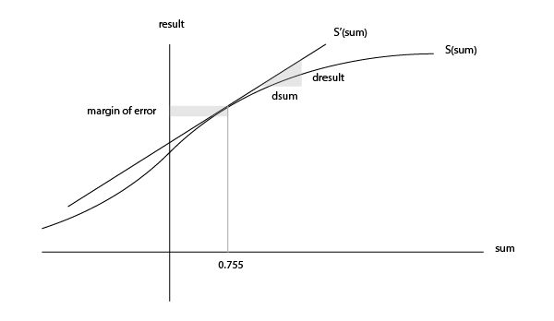



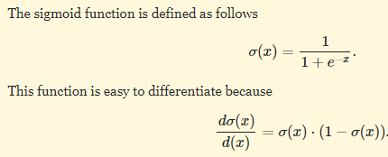
Example
The derivative of sigmoid, also known as sigmoid prime, will give us the rate of change (or “slope”) of the activation
function at the output sum:
sum =s(h1)*w7+s(h2)*w8+s(h3)*w9
calculated = s(sum)

Slide 16

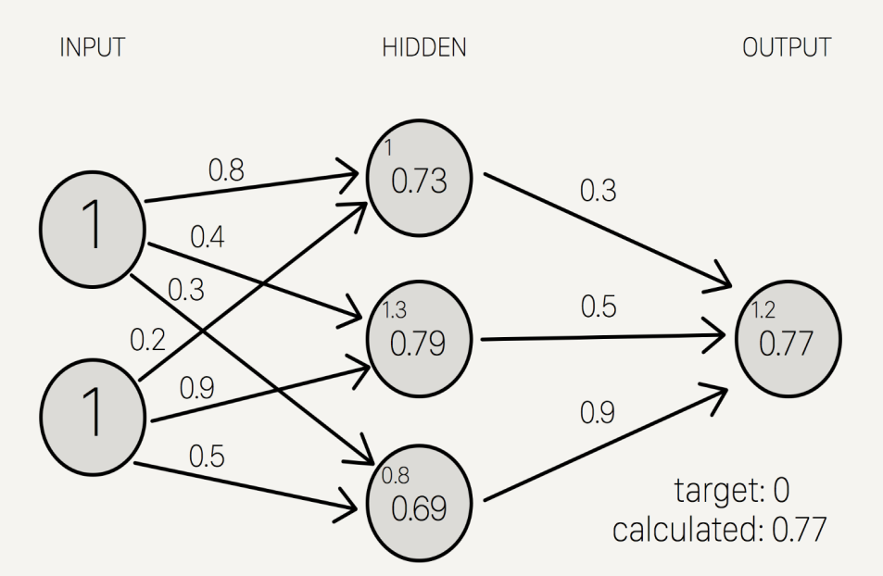


Example
sum =s(h1)*w7+s(h2)*w8+s(h3)*w9
calculated = s(sum)
Delta output sum = S'(sum) * (output sum margin of error)
Delta output sum = S'(1.235) * (-0.77)
Delta output sum = -0.13439890643886018
Delta weights = delta output sum / hidden layer results
Delta weights = -0.1344 / [0.73105, 0.78583, 0.69997]
Delta weights = [-0.1838, -0.1710, -0.1920]

Slide 17
Example
old w7 = 0.3
old w8 = 0.5
old w9 = 0.9
w_{new}=old weights w_{old} + Delta weights
new w7 = 0.1162
new w8 = 0.329
new w9 = 0.708

Slide 18





Example

Slide 19
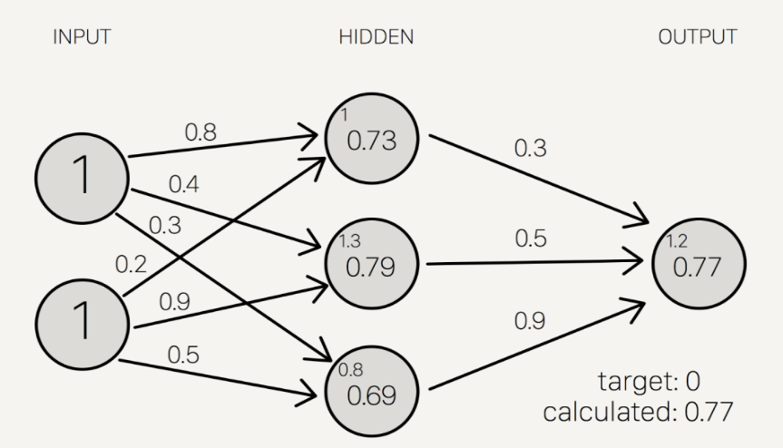
Example
Delta hidden sum = delta output sum / hidden-to-outer weights * S'(hidden sum)
Delta hidden sum = -0.1344 / [0.3, 0.5, 0.9] * S'([1, 1.3, 0.8])
Delta hidden sum = [-0.448, -0.2688, -0.1493] * [0.1966, 0.1683, 0.2139]
Delta hidden sum = [-0.088, -0.0452, -0.0319]

Slide 20



Example

Slide 21
Example
input 1 = 1
input 2 = 1
Delta weights = delta hidden sum / input data
Delta weights = [-0.088, -0.0452, -0.0319] / [1, 1]
Delta weights = [-0.088, -0.0452, -0.0319, -0.088, -0.0452, -0.0319]
w_{new}=old weights w_{old} + Delta weights

Slide 22
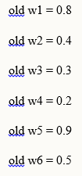
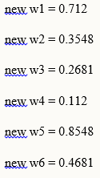
Example
w_{new}=old weights w_{old} + Delta weights

Slide 23
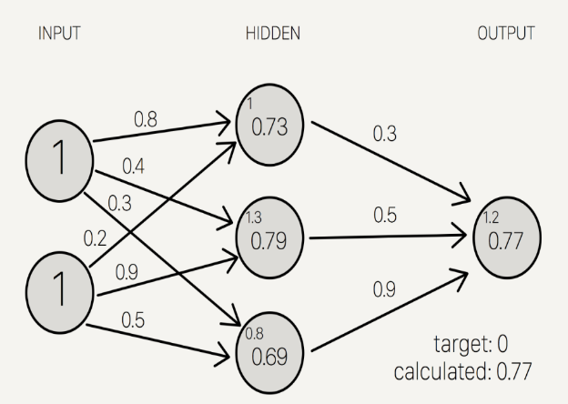
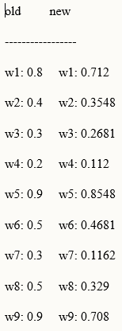
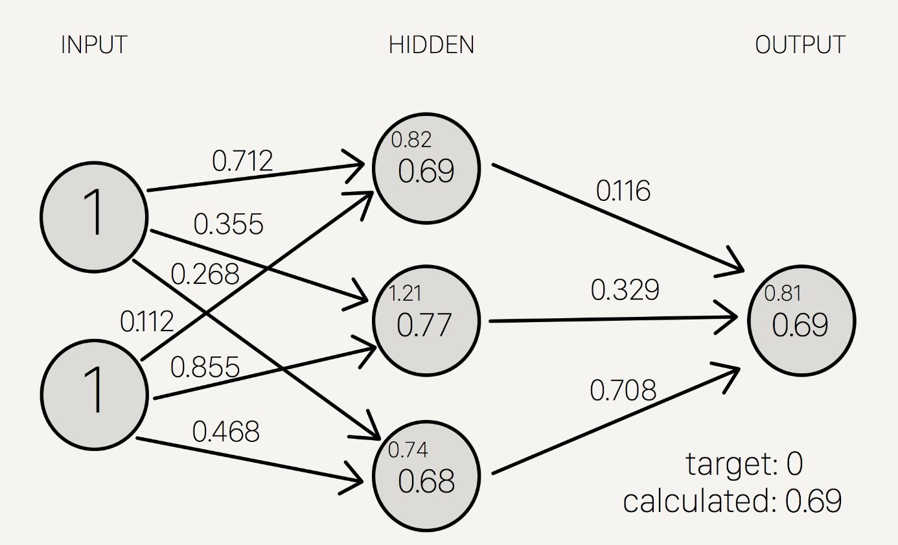
Example

Slide 24
References
https://adeshpande3.github.io/adeshpande3.github.io/A-Beginner%27s-Guide-To-Understanding-Convolutional-Neural-Networks/
https://youtu.be/GlcnxUlrtek
https://pythonprogramming.net/cnn-tensorflow-convolutional-nerual-network-machine-learning-tutorial/
https://github.com/walsvid/GoogLeNet-TensorFlow
https://github.com/taki0112/ResNet-Tensorflow
https://github.com/huyng/tensorflow-vgg
https://github.com/kratzert/finetune_alexnet_with_tensorflow
https://dialogflow.com/
https://www.youtube.com/watch?v=a8JwTqByefU
https://www.simplilearn.com/incredible-machine-learning-applications-article
https://www.youtube.com/watch?v=hPKJBXkyTKM&vl=en

